Slide 1
Analysis of the Best Music of the 2010s
A comprehensive analysis using Spotify Data and Pitchfork’s Top 200 album list
Angel Sarmiento

Slide 2
Introduction

Slide 3
What is in the Dataset?
Valence
Instrumentalness
Acousticness
Danceability
Energy
Loudness
Speechiness
Liveness
Tempo
Joyfulness
No vocality
The track is acoustic
Suitability for Dancing
Intensity/activity
Decibels (Db)
Spoken Words
Track performed live
Beats per Minute (BPM)

Slide 4
Which Genres have the most joyful music?

Slide 5
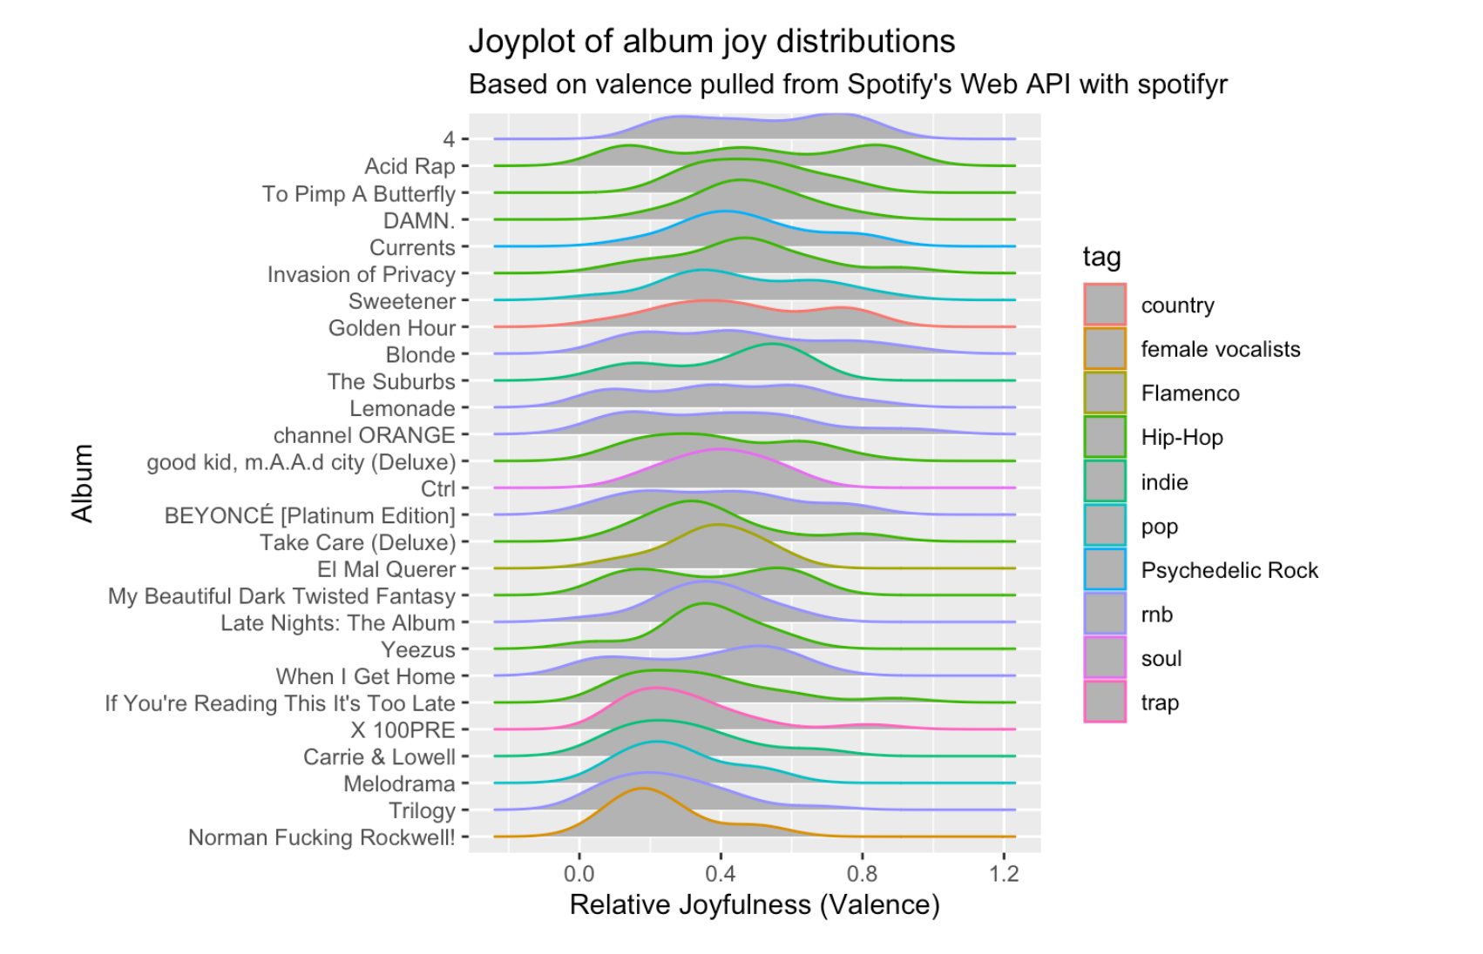
Which Genres have the most joyful music?
Moving down the graph is decreasing joy
RnB Genre takes the top spot
Hip Hop ranks very high despite subject matter

Slide 6
Does sadder music have more words?

Slide 7
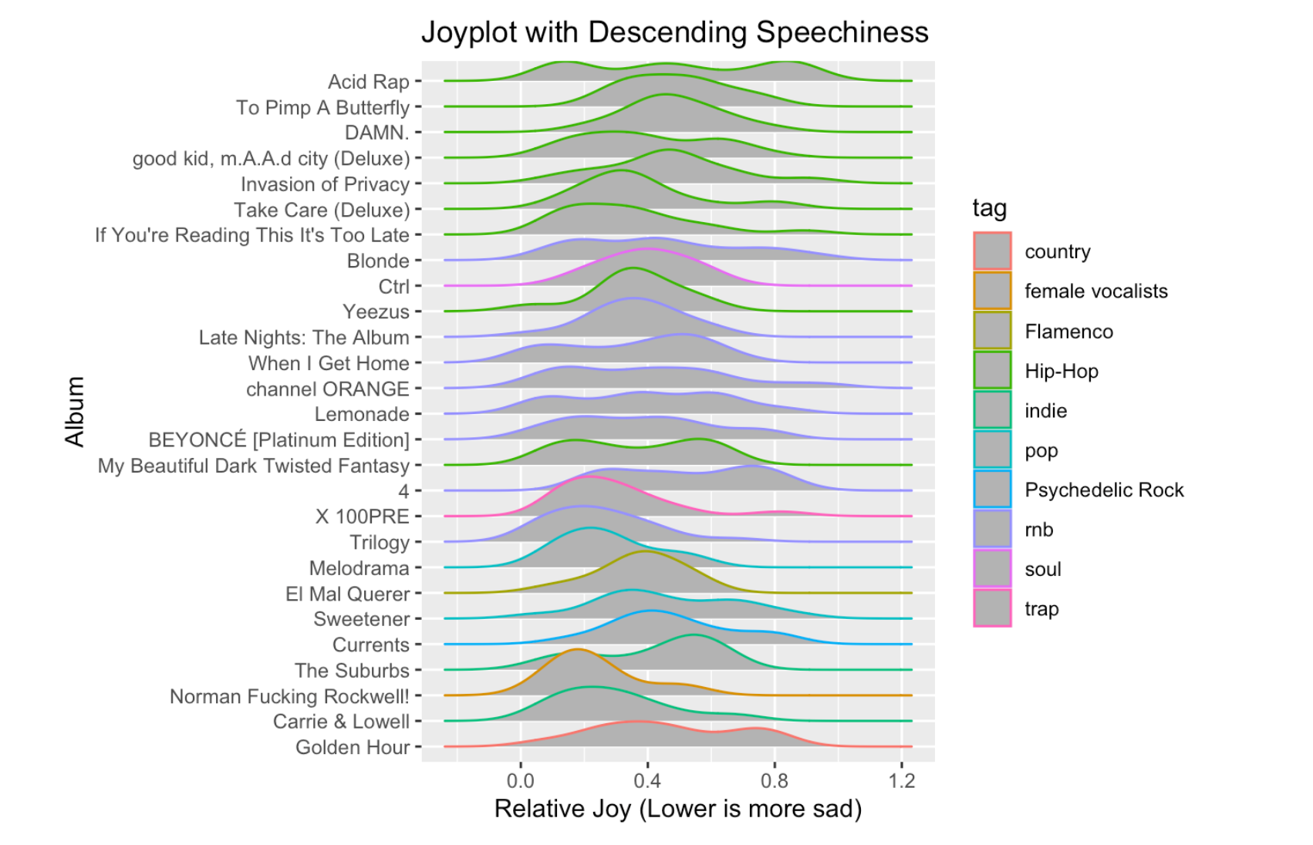
Does sadder music have more words?
Does not seem so. Hip hop is more vocal heavy but still falls behind to RnB and soul.

Slide 8
What is significant in predicting Joyfulness?

Slide 9
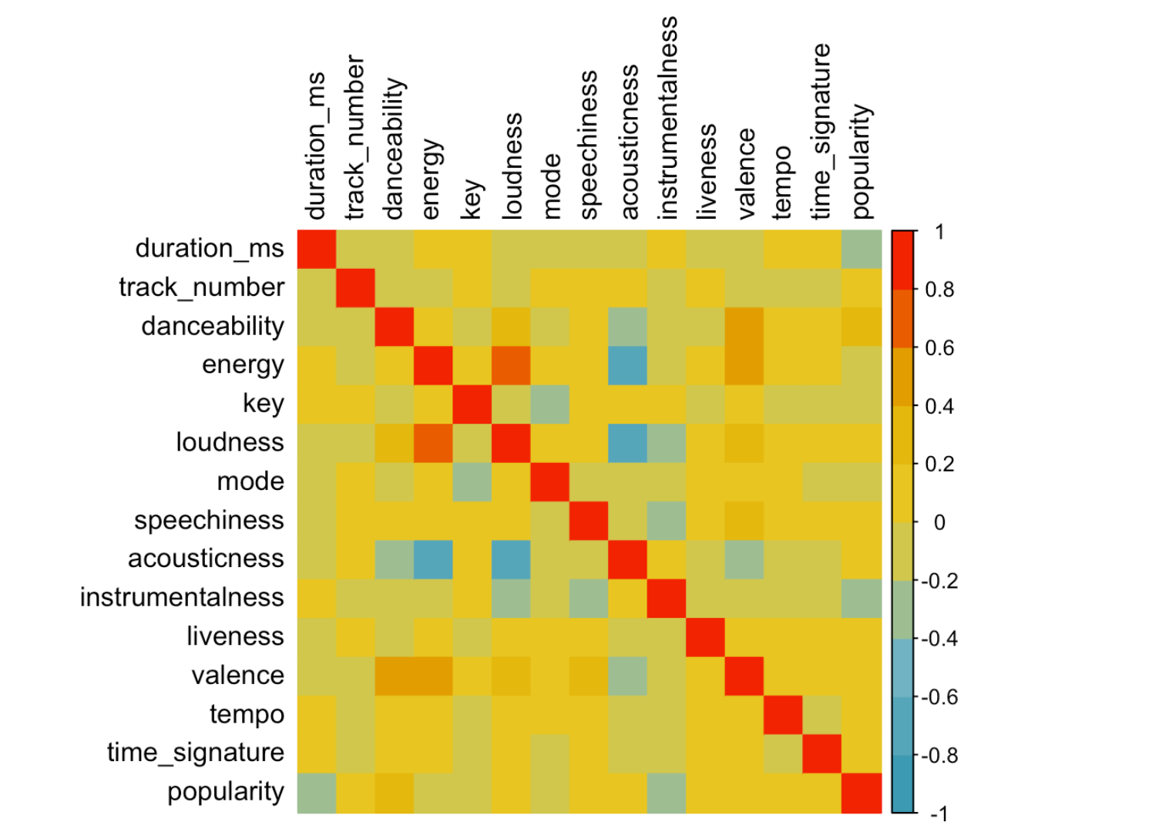
A Linear Model
Multicollinearity?
Multicollinearity seems to be the most likely assumption to be invalidated here
Loudness, energy, and acousticness are highly correlated
Pairwise Interactions
Correlation Plot

Slide 10
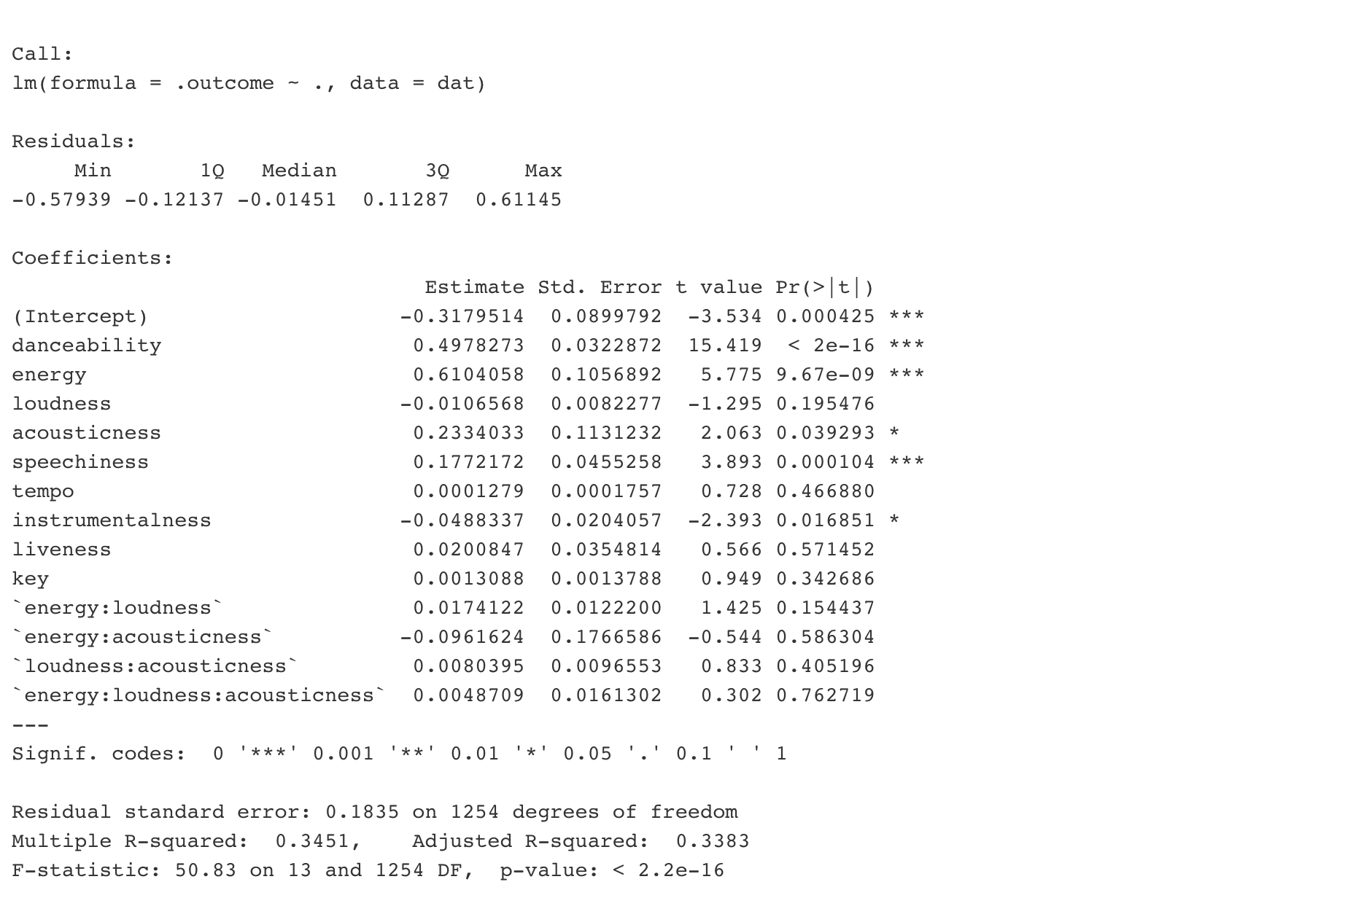
A Linear Model
Danceability, energy, acousticness, speechiness, and instrumentalness are significant.
Low R-squared. Not likely to make a good predictive model of valence.

Slide 11
What is the time trend in songs?

Slide 12
LOESS
Locally Estimated Scatterplot Smoothing
Density based line smoothing
Local dependence
Can see small changes in density-heavy time series data
Non-parametric

Slide 13
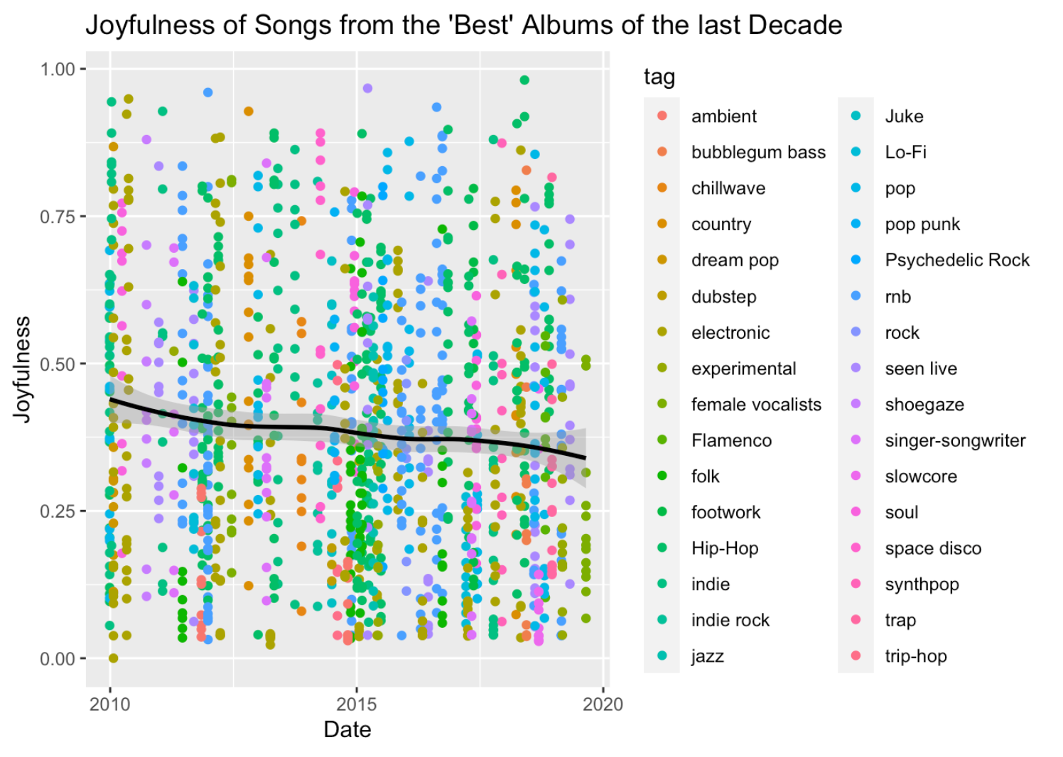
What are the time trends in songs?
There is a general trend downward in joyful songs. The average is more geared toward sad songs.
LOESS line is in black
Regular Linear Model will be in Red

Slide 14
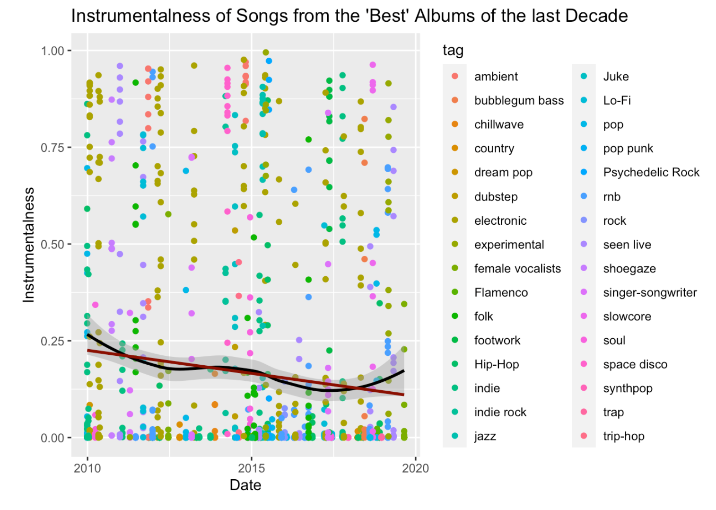
What are the time trends in songs?
There is a general trend downward for instrumental ness insongs. Songs actually have more lyrics over the decade.

Slide 15
What about albums?

Slide 16
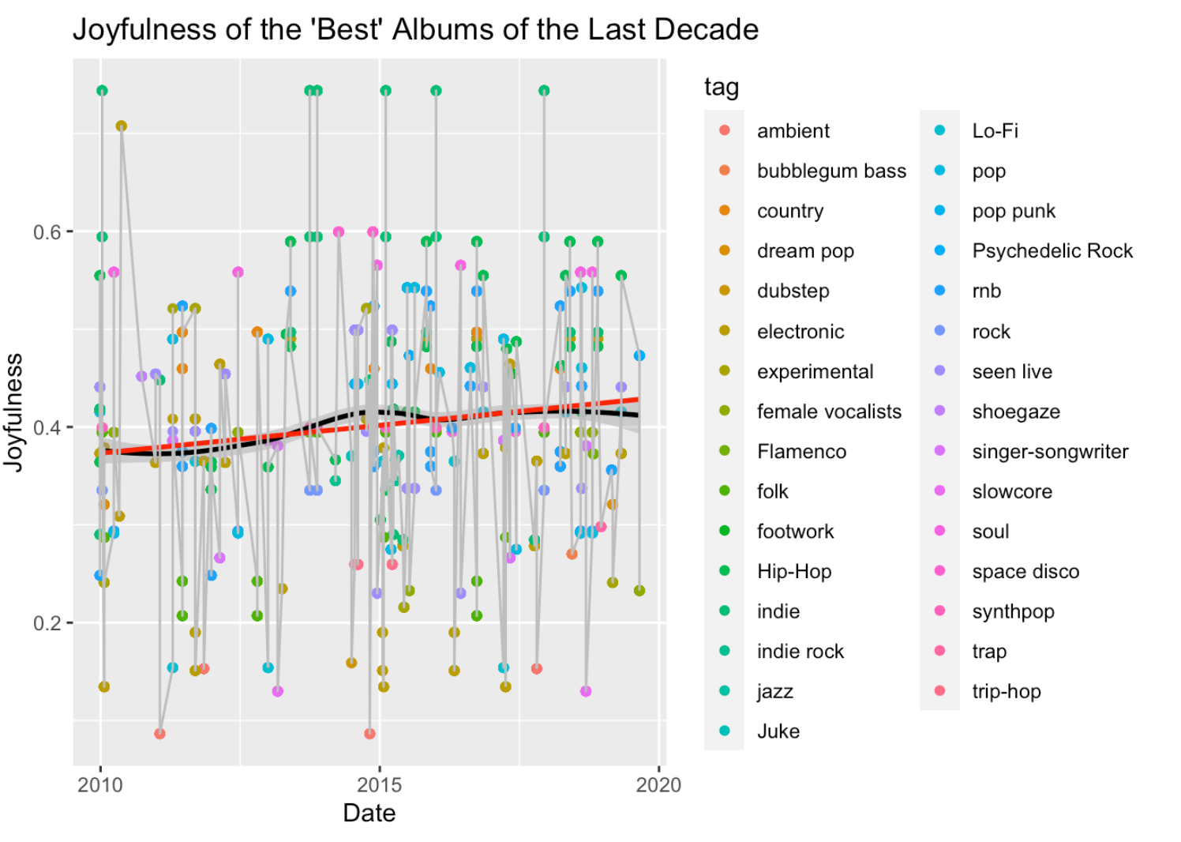
What are the time trends in albums?
For albums, there is actually an upward trend in joyfulness across the decade.

Slide 17
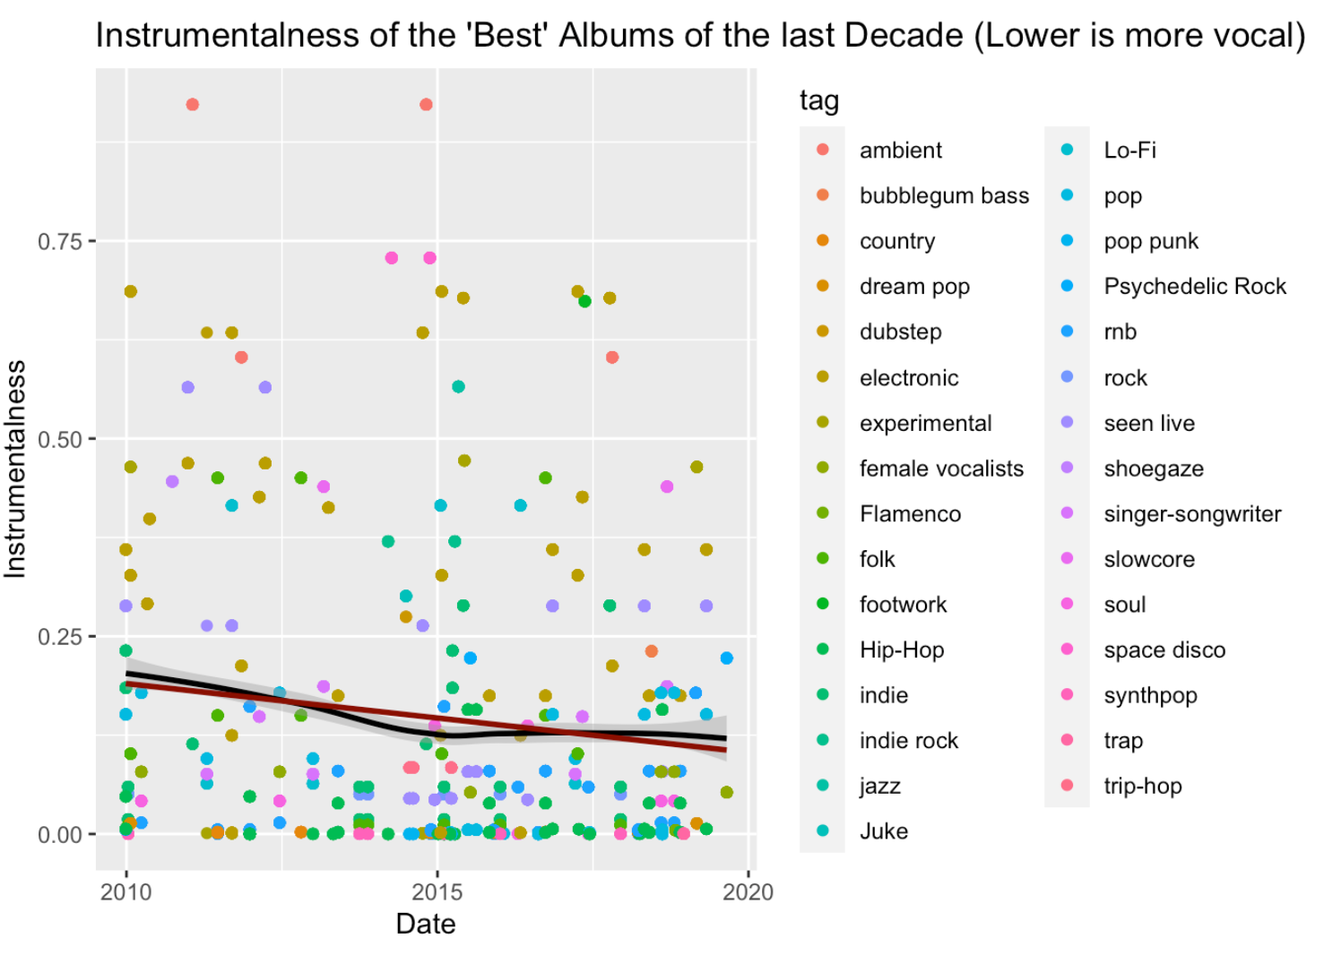
What are the time trends in albums?
For albums, the trend in instrumental ness remains the same.

Slide 18
How are the Genres related?

Slide 19
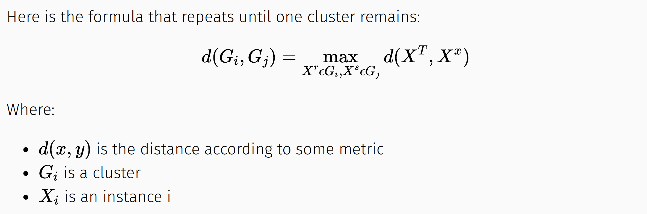
Hierarchical Clustering
Displaying similarities where a hierarchy is established instead of general clustering

Slide 20
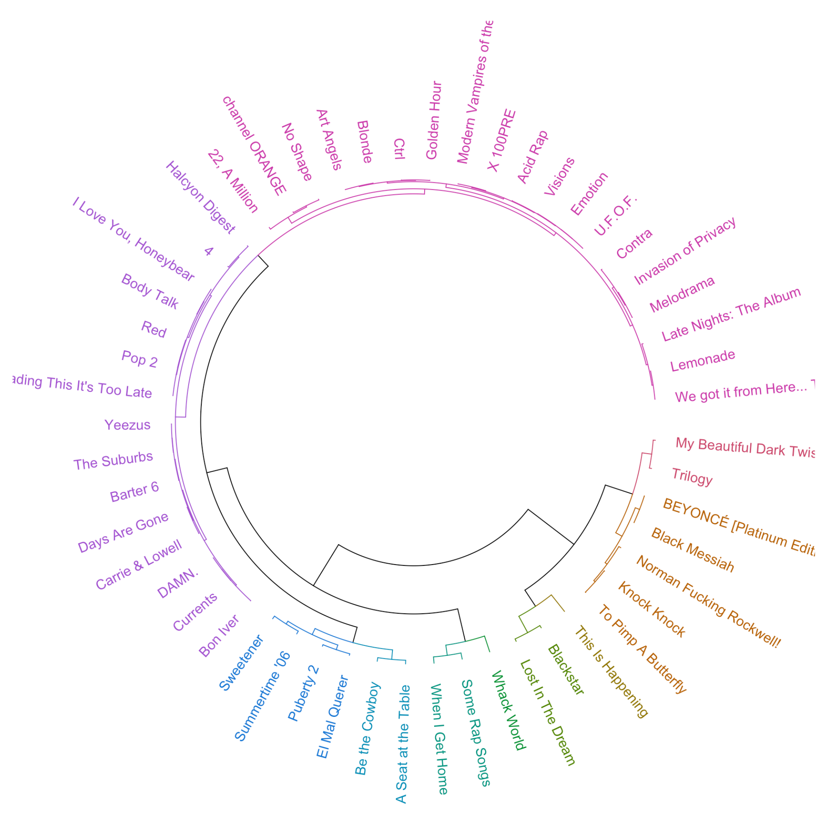
How are the Genres related?
Lots of interesting information here!
Hip Hop albums clustered with Pop, even psychedelic rock albums
RnB albums are largely together (pink) but some
To Pimp a Butterfly(Hip-Hop/funk/soul) linked with Norman F* Rockwell (Alternative/indie)

